Slide 1

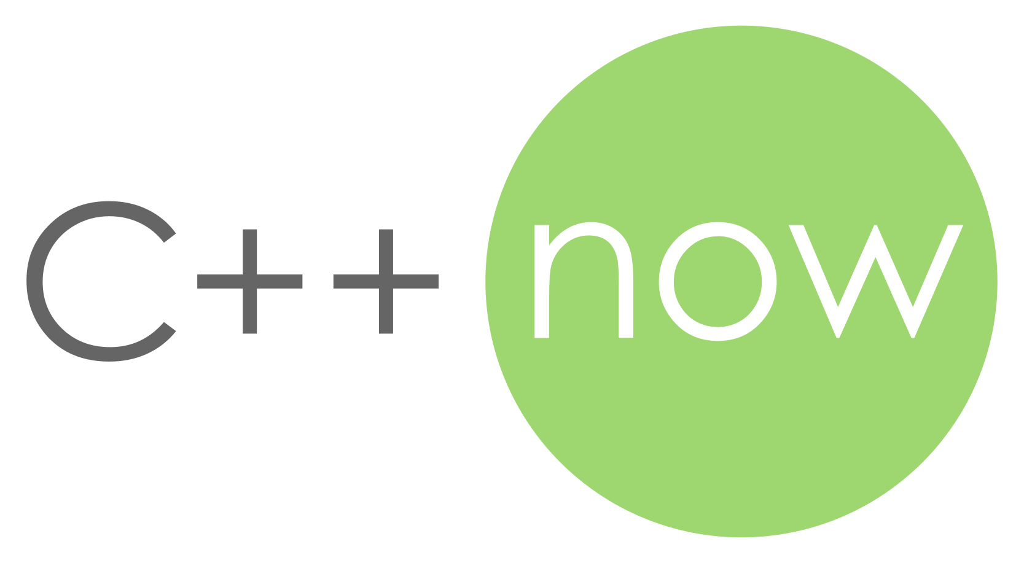

The Plan for Tomorrow
Compile-Time Extension Points for C++ Libraries and Applications
ThePhD - @thephantomderp – LinkedIn - https://thephd.github.io
Columbia University Student, May 10th, 2019
C++Now2019, Aspen, Colorado

Slide 2
Extension Goals: Adding Functionality…
beyond what was initially considered by application / library authors
Callback functions with void* userdata in C libraries
to perform some semantically-expected task for types outside author’s purview
std::swap
to endow a class with a specific, compatible interface
virtual protected functions in iostreams

Slide 3
Well-Known Extension Methods
A brief overview of compile-time and runtime hybrid extension technology

Slide 4
Well-Known: Virtual methods
No surprises here: create base class and stuff it with virtual methods
struct animal { virtual std::string sound () const = 0; };
struct dog : public animal { virtual std::string sound () const override { return “woof”; } };

Slide 5
Well-Known: Virtual methods usage
Used extensively up to ~2008, less so now in place to static polymorphism
Many game engines: Ogre, Irrlicht, Doom, etc…
Qt: QObject and the entire class tree
Clang: ASTMatchers and extension points
C++ standard library: iostream customization points
One too many C++ university classes

Slide 6
Benefits
Can work with super class (base class) at compile-time
calls the right method at runtime
no need to bookkeep function pointers and similar
Heavily optimized by compiler writers to de-virtualize simple cases
E.g.: current-gen non-user-specialized iostreams, C++ XAML, and more

Slide 7
Drawbacks
ABI-brittle
adding a function to class might append to virtual table, but may insert in middle of derived class’s virtual table
difficult to detect mismatches
Runtime efficiency
Does “X” need to be virtual? Must decision be delayed to runtime?
Implementation-controlled Virtual Tables / Slicing Problem
Base classes must be handled as pointers / references or risk slicing

Slide 8
Callbacks with Userdata
Function which takes a strongly-typed function pointer and a void* userdata
Staple of C APIs everywhere, including some C standard library functions
Highly flexible
Used to let (application) developer do things beyond what was envisioned
e.g., serialize data into to a std::vector instead of a FILE*
typedef int (*lua_Writer)(lua_State*, const void*, size_t, void*);
int lua_dump(lua_State* L, lua_Writer writer, void* userdata, int strip_symbols);

Slide 9
Well-Known: Callbacks with userdata usage
Literally every C library, ever…
Lua, libclang,
libpng, libjpeg
jansson, libev, freetype
Win32: everywhere
C Standard Library: qsort

Slide 10
Easy to wrap in C++
Typical C call, wrapped in C++
template <typename Callback>
int dump_handler(lua_State* L, const void* data, size_t data_size, void* userdata) {
Callback& callback = *static_cast<Callback*>(userdata); return callback(L, data, data_size);
}
template <typename Callback>
void dump_with(lua_State* L, Callback&& callback, bool strip_symbols = true) {
lua_Writer writer = &dump_handler<std::remove_reference_t<Callback>>;
void* userdata = static_cast<void*>(std::addressof(callback)); lua_dump(L, writer, userdata, static_cast<int>(strip_symbols));
}

Slide 11
Easy to wrap in C++: No Templates
Fix the interface to save on template duplication for every callable…
using dump_function = std::function<lua_State*, const void*, size_t>;
int dump_handler(lua_State* L, const void* data, size_t data_size, void* userdata) {
dump_function& callback = *static_cast<dump_function*>(userdata); return callback(L, data, data_size);
}
void dump_with(lua_State* L, dump_function callback, bool strip_symbols = true) {
lua_Writer writer = &dump_handler;
void* userdata = static_cast<void*>(std::addressof(callback)); lua_dump(L, writer, userdata, strip_symbols);
}

Slide 12
Easy to wrap in C++: No Templates
std::function is expensive
Higher efficiency, low cost for (maybe) C++20: std::function_ref
using dump_function = std::function_ref<lua_State*, const void*, size_t>;
int dump_handler(lua_State* L, const void* data, size_t data_size, void* userdata) {
dump_function& callback = *static_cast<dump_function*>(userdata); return callback(L, data, data_size);
}
void dump_with(lua_State* L, dump_function callback, bool strip_symbols = true) {
lua_Writer writer = &dump_handler;
void* userdata = static_cast<void*>(std::addressof(callback)); lua_dump(L, writer, userdata, strip_symbols);
}

Slide 13
Easy…?
Inline and synchronous execution:
No need for storage
No need to manage lifetime
Non-inline execution:
Callling it later (events in Qt, libev, etc.)? Need storage.
Multithreading? Need storage.
Storage means lifetime…

Slide 14
Benefits
Space and time efficient
especially if callback never needs to be stored
function pointers are cheap
ABI-hardy
difficult to break ABI unless the actual callback interface changes
user can place extra data into void* for their needs at no cost to library

Slide 15
Drawbacks
Exception/early exit issues
if stored, is the callback called when an exception is tossed/failure is reported?
In-lining optimizations for compiled code becomes restricted
qsort(…) vs. std::sort(…)
link time optimizations helps here
Lifetime issues, when
storing the callback to call “at a later date”
multithreading concerns

Slide 16
Compile-Time Extension
Picking and choosing work to execute using compile time choices

Slide 17
Extension Methodologies 📜
Compiler-Assisted
(Partial) Class Template Specializations
“Koenig”/Argument-Dependent Lookup (ADL)
Static friend functions
Template functions + Overloading
Author Mandated
Traits/Policy/Agent templates

Slide 18
Class Templates + Specialization
Uses a class template
User then (partially) specializes a class for this template
Case studies: sol2, std::hash
Base template, user specialized templates
Using this class:
struct two_things { int a; bool b; };

Slide 19
sol2 and std::hash
case studies in class template specializations

Slide 20
sol::stack::getter<T, C>
// sol.hpp, sol2
namespace sol { namespace stack { template <typename T, typename C = void> struct getter { static T get(lua_State*, int, record&) { /* default implementation here */ } }; }} // namespace sol::stack

Slide 21
full specialization
// user.cpp
namespace sol { namespace stack { template <> struct getter<two_things> { static two_things get(lua_State*, int, record&) { /* user code here */ } }; }} // namespace sol::stack

Slide 22
Partial Specialization
namespace sol { namespace stack { template <typename T>
struct getter<T, std::enable_if_t<std::is_arithmetic_v<T>>> {
static T get(lua_State*, int, record&) {
/* implementation for all numerics */
}
}; } // namespace sol::stack

Slide 23
Drawback: Mutual Exclusion
Fail to separate base implementation versus user implementation
All user customization points must occupy the same finite code space
All full and partial specializations must not collide (mutual exclusion principle)
Bad design in sol2 led to a few annoying collisions/fighting with user specializations
💥
✔️
✔️

Slide 24
Drawback: specialization collisions
namespace sol { namespace stack { template <typename T>
struct getter<T, std::enable_if_t<std::is_integral_v<T>>> {
// ^ ERROR: ambiguous specialization
static T get(lua_State*, int, record&) {
/* implementation for integers */
}
}; } // namespace sol::stack

Slide 25
Drawback: specialization collisions
namespace sol { namespace stack { template <>
struct getter<std::string> {
// ^ ERROR: multiple matches (sol2 has one already)
static std::string get(lua_State*, int, record&) {
/* implementation for std::string */
}
}; } // namespace sol::stack

Slide 26
Drawback: specialization collisions 💥
user.hpp
lib.hpp
template <typename T>
struct custom_point<T, std::enable_if_t<
has_begin_end_v<T>
>
>
{
/*… */
};
template <typename T>
struct custom_point<
my_vector<T>
>
{
/*… */
};
E R R O R

Slide 27
Drawback: visibility and defaults 👀
Is the class template specialization…
visible in all possible translation units where it may be used?
body dependent on macros that are not defined for the entire build (and its dependencies?)
Silent ODR violation that compiles, links and runs on all known compilers.
Problematic with all compile-time extension points where default is not a noisy error
📦 Specialization must be tightly packaged with class when used!
https://thephd.github.io/oh-dear-odr-trap

Slide 28
Visibility and Defaults Fix?
Undefined base template instantiation
Errors users when nothing matches with (cryptic) “there is no defined class here”
Impossible when you have a default implementation!
template <typename T>
struct my_customization_point; // undefined base

Slide 29
Fix: Slightly better
Define base template, but static assert to give better error than compiler
Still impossible when you have a default implementation!
template <typename T>
struct my_customization_point {
static_assert(always_false<T>::value, “no customization point was picked up; ” “please define one or check your code!”);
};

Slide 30
Drawback: Extra Template Args
Extra template argument is needed on every extension point for SFINAE traits to be applied
SFINAE is messy
decltype() and is_detected SFINAE slightly less ugly than std::enable_if_t
introduces mutual exclusion principle problems
template <typename T>
struct custom_point<T, /* SFINAE here */> {
/* … */
};

Slide 31
Quick C++20 Fix: Concepts
Concepts allow for simpler partial specialization and remove SFINAE parameter
template <ContainerLike T> // concept-constrained
struct custom_point<T> {
/* … */
};

Slide 32
Drawback: “arcane” knowledge 🧙
“The code isn’t working”
navigating the syntax and rules of template instantiations means glazed over looks and general confusion
when providing support, usually teach user about partial template specialization (or just give them an example)
Typical C++ users just want to write simple code
Classes (with or without static functions): ✔️
Functions (exported, inline, etc.): ✔️
Templates (rules of ODR, visibility of specialization at time of use, etc.): ❌

Slide 33
Drawback: header bloat 🎈
Header contamination becomes a real problem to avoid ODR issues
entirety of sol2 comes along for the ride
produces longer build times
avoided with careful forward declaration of every required template and class
unfortunately, the standard itself does not provide forward-declaring headers
“modules will solve it?” – unfortunately, little tangible evidence I can personally provide

Slide 34
std::hash<T>
Employs same struct specialization technique, but
is substantially simpler
has only one template argument
Well-used, so this simple case has become idiomatic
lack of pre-C++20 SFINAE makes it easier to teach
👨🏽‍🏫

Slide 35
std::hash<T> Example
namespace std {
template<> struct hash<two_things> { size_t operator()(const two_things& tt) const noexcept { auto h1(std::hash<int>{}(tt.a)); auto h2(std::hash<bool>{}(tt.b)); return my_hash_mix(h1, h2); // boost::hash_combine } };
} // namespace std

Slide 36
benefits and drawbacks
Good: avoids arcane knowledge requirements by
being extraordinarily simple (write a function call operator)
not having a SFINAE parameter (avoids mutual exclusion)
Bad: takes core specializations away from user
Pre-defined for enum types, integral types, etc.
No opt-out or overriding of those defaults
Same visibility / header contamination issues
<functional> comes along for the ride 🐪, no forward declarations!

Slide 37
C++20 Concepts: Drawback?! 🤯
Previously non-constrainable generic templates like std::hash are now… constrainable?!
namespace std {
template <Conceptified T> struct hash<T> { size_t operator()(const T&) const noexcept {
/* what have we done…? */
} };
} // namespace std

Slide 38
Frequent library vendor complaint
“They are opening up namespace std / my namespace 💢!”
paper to solve this presented in Rapperswil, Switzerland, 2018; p0665
allows a user to specialize outside classes in the namespace where the class is defined
Library vendors are hyper-sensitive to users opening up namespace std
people have done all sorts of interesting things in their code bases
required all large stdlib implementations to employ __ugly _Identifiers for realsies

Slide 39
(Template) Functions
Friendship and Overloading and ADL, oh my!

Slide 40
(Template) Function Overloading
Step into the namespace of the function and add a similar name
does not depend on Name Lookup to “find” the function in associated namespaces
Usually explicitly blessed by library author as “possible”
old usage: viable way to customize std::swap
Case study
Boost.Serialization

Slide 41
Adding overload into Boost.Serialization:
namespace boost { namespace serialization { template <class Archive> void serialize(Archive& ar, two_things& tt, unsigned int version) { ar & tt.a; ar & tt.b; }
}} // namespace boost::serialization

Slide 42
Overloading: benefits and drawbacks
Direct additions to namespace separate extension point from target
benefit: if optional and not required, user can move customization function to independent header / implementation files
drawback: if required and not optional, then separation may not be desired and causes boilerplate/errors (“I forgot to include the special header for serialization”)
Same complaint from library vendors
opening up other namespaces 💢!
potential for name collisions and similar

Slide 43
Increasing Encapsulation: Friend
struct two_things { private: friend class boost::serialization::access; template <class Archive> void serialize(Archive& ar, unsigned int version) { ar & a; ar & b; } public:
int a; bool b; };

Slide 44
Friend: benefits and drawbacks
Tight coupling!
benefit: if required, desirable to make it inseparable
drawback: compilation times for demanding Boost.serialization come along with the main header
Makes library vendors happy
Titus Winters and the abseil team are smiling down at us (https://abseil.io/tips/99)

Slide 45
Argument-Dependent Lookup 👾
Complicated set of rules
Rely on namespaces of arguments to add additional symbols to unqualified calls
primary intentional use: “generic” (templated) code to work with arbitrary types
primary unintentional use: operators to “just find the right call” for a == b
Case studies:
std::swap (the wrong way)
std::ranges / range-v3 (the right way)

Slide 46

Argument-Dependent Lookup: swap
swap(a, b) // invokes ADL because call name is unqualified
looks in the namespace of a and b, as well as the current scope’s namespace
likely a bug in generic algorithm if written outside std/a or b are not std
std::swap(a, b) // does not invoke ADL because call name is qualified
looks only in namespace std
likely a bug if used in a generic algorithm
Proper way:
using std::swap;
swap(a, b);

Slide 47

“Std Swap Two-Step”: verbosity is failure
“The problem with the Two-Step is that it forces users to type more to do the right thing. FAIL. Most damning, it requires users to either blindly memorize and regurgitate the Two-Step pattern, or worse: understand two-phase name lookup in templates.” – Eric Niebler, October 2014, http://ericniebler.com/2014/10/21/customization-point-design-in-c11-and-beyond/

Slide 48
Argument Dependent Lookup: range-v3
Create a callable function object which does the two-step with an internal detail namespace’s swap
Invokes ADL but prevents qualified call to ns::swap(a, b) being a bug
ADL is done “for you”: function object takes care of it

Slide 49
ADL Done Right™
namespace std { namespace detail {
template <Swappable A, Swappable B> // important!
void swap (A& a, B& b) { /* default implementation */ }
struct swap_func {
template <Swappable A, Swappable B>
void operator()(A& a, B& b) const noexcept {
swap(a, b); // default swap already in scope
}; };
}} // namespace std::detail

Slide 50
ADL Done Right™
Create a constexpr object of the proper name sitting in the namespace
namespace std {
// C++17: inline variables clue compiler in to avoid ODR
inline constexpr const auto swap = detail::swap_func{};
} // namespace std

Slide 51
ADL Done Right™ (C++14 and below)
Create a constexpr object of the proper name sitting in the namespace
C++17: inline constexpr to avoid ODR issues, rather than __static_const trick
namespace std {
// older standards:
template <typename T>
struct __static_const { static constexpr T value{}; } template <typename T>
constexpr __static_const<T>::value;
constexpr const auto& swap = __static_const<detail::swap_func>::value;
} // namespace std

Slide 52
ADL Done Right™: very simple
struct two_things {
int a;
bool b;
// just this
friend void swap (two_things& left, two_things& right);
};

Slide 53
Wait, is that a friend function?
Friend functions contain a few encapsulation benefits and help avoid name collisions
friend functions are the same as free functions, but:
hidden from qualified (my_namespace::func_name) calls due to being inside the class
Findable (only) by calls which invoke ADL

Slide 54
friend functions case study: abseil
Abseil uses this extensively for its customization points
in particular, AbslHashValue
struct Circle {
template <typename H>
friend H AbslHashValue(H h, const Circle& c) {
return H::combine(std::move(h), c.center_, c.radius_);
}
private:
std::pair<int, int> center_;
int radius_;
};

Slide 55
Benefits: ADL Done Right™
No Two-Step;
no subtle missed bugs in generic code
no inconsistency in “always qualify your calls”
Customization point writer gets there “first”
impose initial base-level concepts on the type
Allows user to define swap in namespace next to class / as friend function
just a function: easy to write and read

Slide 56
Drawback: overloading catch-alls
Base implementation provided by author must SFINAE away or it will catch all calls and hard-error everything
must use decltype SFINAE, concept, trailing return type with decltype or std::enable_if_t
Users may not properly constrain their overloads and write catch-alls
If users write a “generic” catch-all and do not properly constrain, the extension point is ruined for everyone

Slide 57
Drawback: High Collisions
Does your function take perfect forwarding references?
prepare to cry: overloads in the same space may consume more calls than intended
worse: they might even unintentionally work but do the non-performant / wrong thing!
namespace std {
template <class Pointer, class Smart, class... Args>
auto out_ptr(Smart& s, Args&&... args) noexcept;
} // namespace std

Slide 58

Drawback: High Collisions
Basically working with a black hole
Avoid ADL for variadic forwarding functions: not a good time
namespace std {
template <class Pointer, class Smart, class... Args>
auto out_ptr(Smart& s, Args&&... args) noexcept;
} // namespace std

Slide 59
Must Constrain Base Implementation!
namespace std { namespace detail {
template <typename A, typename B>
void swap (A& a, B& b) -> decltype(a.swap(b)) { /* … */ }
template <Swappable A, Swappable B>
void swap (A& a, B& b) { /* … */ }
// and more…
}} // namespace std::detail

Slide 60
But everyone will properly constrain!
And other lies I told myself after I read Eric’s blog post…

Slide 61

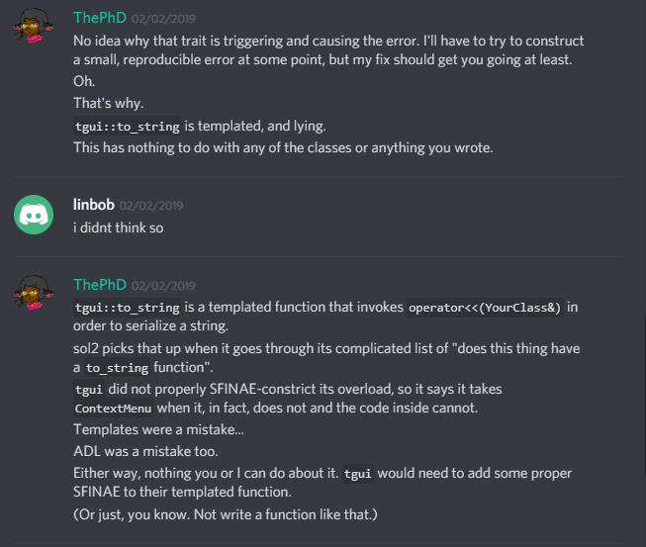
No.
They will not constrain it.
They will not use “only concrete types”.
The world is not full of only experts.

Slide 62
ADL Done… Right™?
“The Best Anyone Could Have Done With The Tools At Hand.”
range-v3 niebloids (begin, end, iter_move, dereference, etc.) contain no opt-out mechanism
does not prevent the ADL problem for unintentionally bad actors
makes it even more apparent when it does happen
cannot call “just the basic {begin/end/swap}” because it exists in an implementation-defined detail namespace now

Slide 63

ADL and Overloading: Bigger Problems
Functions can catch unintended calls
even if they are not templated
consider void* pointer conversions, derived -> base conversions, and more
Results in a huge problems for ADL and overloading
unintended “catches” of base types and other things a user would find surprising
Case study: sol3

Slide 64
ADL extension points
Associated extension points (not named the same!)
sol::stack::get a value maps to sol_lua_get
sol::stack::check a type maps to sol_lua_check
sol::stack::push maps to sol_lua_push
int sol_lua_push(sol::types<two_things>, lua_State* L,
const two_things& things);
two_things sol_lua_get(sol::types<two_things>, lua_State* L,
int index, sol::stack::record& tracking)
template <typename Handler>
bool sol_lua_check(sol::types<two_things>, lua_State* L,
int index, Handler&& handler, sol::stack::record& tracking)

Slide 65
“Did You Customize This”: Type trait implementation
template <typename... Args>
using adl_sol_lua_push_test_t = decltype(sol_lua_push(
static_cast<lua_State*>(nullptr), std::declval<Args>()...
));
template <typename... Args>
inline constexpr bool is_adl_sol_lua_push_v =
is_detected_v<adl_sol_lua_push_test_t, Args...>;

Slide 66
sol3: ADL extension point function call
template <typename T, typename... Args>
int push(lua_State* L, T&& t, Args&&... args) {
if constexpr (is_adl_sol_lua_push_v<T, Args...>) {
return sol_lua_push(...);
}
else {
/* hit default if constexpr internals */
}
}

Slide 67
sol3: an example of old problems
Why type tags?
To solve conversion problems; for example, pointer conversion rules
int sol_lua_push(lua_State* L, void* vp);
struct unrelated {};
int main (int, char*[]) {
sol::state lua{};
unrelated obj{};
unrelated* some_pointer = &obj;
// calls the above, not the default!
sol::stack::push(lua, some_pointer);
return 0;
}

Slide 68
Drawbacks: ADL and overloads
Must guard against conversions
can develop smarter and more complicated traits
prefer a type tag if the space of the ADL is unconstrained
Have templated functions that take multiple perfect-forwarding arguments?
just do not bother here; overload resolution will drive users crazy

Slide 69
Traits Types
Injecting compile-time extensions into the type system

Slide 70

Traits/Policies/Agents: templated classes
Deployed for classes which need customizability
std::basic_string<CharType, TraitsType>
std::basic_ostream<CharType, TraitsType>
std::vector<T, Allocator>
std::map<Key, Value, Predicate, Allocator>
glm::mat<Rows, Colums, Type, Precision>
nlohmann::basic_json< MapType, ArrayType, StringType, BoolType, SignedIntegerType, UnsignedIntegerType, FloatingType, Allocator, Serializer >;

Slide 71
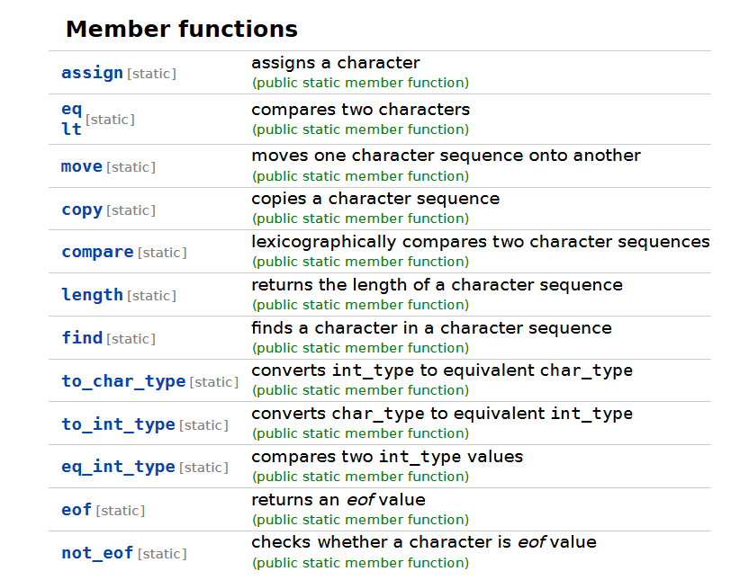
Traits: Bad Reputation
Interfaces for char_traits, allocators, and more from the standard
early designs using new features in the standard
not thoroughly vetted
imbued in things it had no business being in (IO and friends)

Slide 72
Traits: later iterations successful
std::map and std::unordered_map made better use of traits
Predicate and Hash follow guidelines of std::hash
Single-responsibility principle for Predicate and Hash
nlohmann::json is a templated type with sensible defaults
just change template parameter details if you do not like them!

Slide 73
Nlohmann::json
Does extensibility for its to_json / from_json calls by default as adl_serializer
Default serializer is actually really bad: default-constructs object, passes in ref to that object to fill in
But… nothing stops you from doing the following:
using json_but_with_good_serializer
= nlohmann::basic_json<…, good_serializer>; using json_but_with_optimized_map =
nlohmann::basic_json<spp::sparse_hash_map, …>;

Slide 74
Benefits
Easier to customize for user’s needs
“I just need this one behavior in this localized area”
Follows Chandler’s C++ Principle
Pretty good performance by default, but then can flip the car hood up and start customizing things

Slide 75
Drawbacks
Change the template, change the type
cannot interoperate with sibling types by default (unless explicitly programmed in)
Brittle ABI
change default template parameters -> change name mangling
change template name -> any using/typedefs change name mangling
“Too much customizability”
Need to resist temptation to repeat mistake of std::char_traits

Slide 76
So… Which Do We Use?

Slide 77
🤷‍♀️ It Depends 🤷‍♀️
Each scenario has benefits and drawbacks
A bit of guidance for the scenarios

Slide 78

Struct Specialization: best for Precise Matching
Class SFINAE is some of the most expensive SFINAE one can perform
second only to non-concept function SFINAE in template arguments
SFINAE done on the return type of a function is faster
if constexpr is fastest
Template matching is very precise and does not do even basic conversions
less flexible than overload conversions
must define template for base class, first derived, second derived, etc. even if they are all do the same thing
Guidance: use for precise matching, internal details, no conversions

Slide 79
ADL: better for stateless consistency
📞 ⚡
📞
“pick up and play” feeling
works from anywhere, obeys the same rules (however complicated)
better for the library developer space
sol3 picked ADL extension points for many reasons
user had to be able to be consistent across translation units
harder to have fixed ABI with trait-based state classes
sol::state / sol::state_view can work with underlying VM from anywhere
better for handling type-deficient Lua and C coding environment (interop)

Slide 80
ADL: Stateless and Old Code
📞 ⚡
📞
Guidance: use niebloids (range-v3) style...
when you know user does not need access to base implementation
when you are confident user will not do things to step on base implementation’s toes
when you want to make sure someone can pass the functions to higher order functions
Guidance: use sol3 separate-named-function style…
when getting to the default behavior in a well-defined way matters
when users are likely to define a large set of customizations
when users will be working with types they do not own often

Slide 81
Traits: better for multithreaded environments
For when user has more control over the system and does not have to work in existing code
each class can have highly customized behavior specific to needs
avoids needing to share a single global universe of overload resolution / ADL space with others
great for application space
great for environments that are already type-rich / generic (C++)
Can deploy one trait class in one area, another in a separate area
avoids ODR at the cost of having more types
highly-tailored needs

Slide 82
Future Talks?
Fully Runtime Extension Points for C++ Applications
Unassisted Runtime DLL Loading
LoadLibrary + GetProcAddress / dlopen + dlsym
Hooking
mhook / LD_PRELOAD
Hot Reloading
Debug Gap Placements to compile new code into
Visual C++ debug compilation
“Versioning” for the purposes of loading/calling code
ABI restrictions and friends

Slide 83
Future Talks?
“The Future of Customization Points in C++23: Customization Point Functions”
Matt Calabrese’s p1292: https://wg21.link/p1292
He didn’t sign up to do this talk, but he is introducing a paper which makes customization points easy to write, read and reason about
I think it would be a cool talk.
Hint hint.
Wink wink.
Nudge nudge.

Slide 84
Future Talks?
“The Future of Customization Points in C++23: Customization Point Functions”
Matt Calabrese’s p1292: https://wg21.link/p1292
He didn’t sign up to do this talk, but he is introducing a paper which makes customization points easy to write, read and reason about
I think it would be a cool talk.
Hint hint.
Wink wink.
Nudge nudge.
^{Hey Matt do the talk.}

Slide 85





Thank You !
Eric Feselier, Titus Winters
Challenged me to research generic extension mechanisms for std::out_ptr (p1132)
Isabella Muerte
“Tell them an ADL customization point is insane” (she was right; overloading concerns were insane)
Lounge<C++>, include<C++>

Slide 86




Questions?
@thephantomderp
https://twitter.com/thephantomderp
The Pasture
https://thephd.github.io
Patreon - thephd
https://www.patreon.com/thephd
LinkedIn - thephd https://www.linkedin.com/in/thephd

